Slide 1
Fundamentals of Accelerated Data Science
NVIDIA Deep Learning Institute

Slide 2
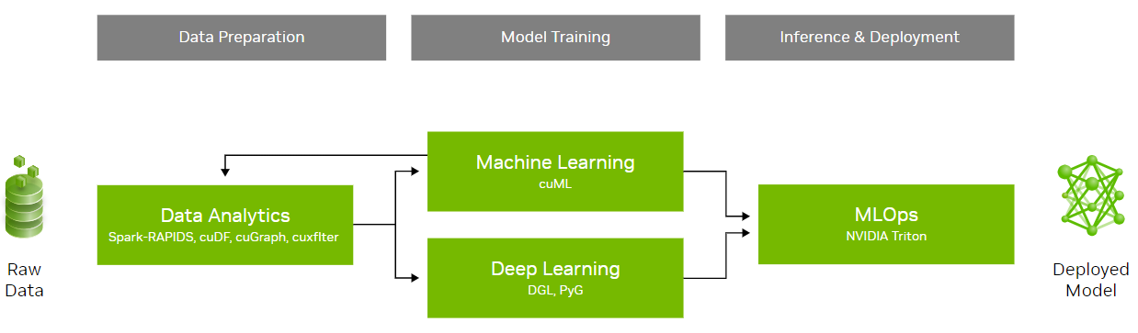
What This Course Will Cover
An Introduction to Data Science with a Focus on Speed and Efficiency
Learning objectives:
Overview of data science
Demonstrations of accelerated data science pipelines
How acceleration is achieved and its implications
This workshop will not cover:
Neural networks (accelerated by cuDNN)
Statistical analysis
 | Course Outline
Task 1 | Data science overview Data manipulation
Task 2 | Machine learning
Task 3 | Graph analytics
Coding Assessment | Biodefense

Slide 3
Agenda
• | Graph 101
• | Graph Analytics
• | Hands-On Lab

Slide 4
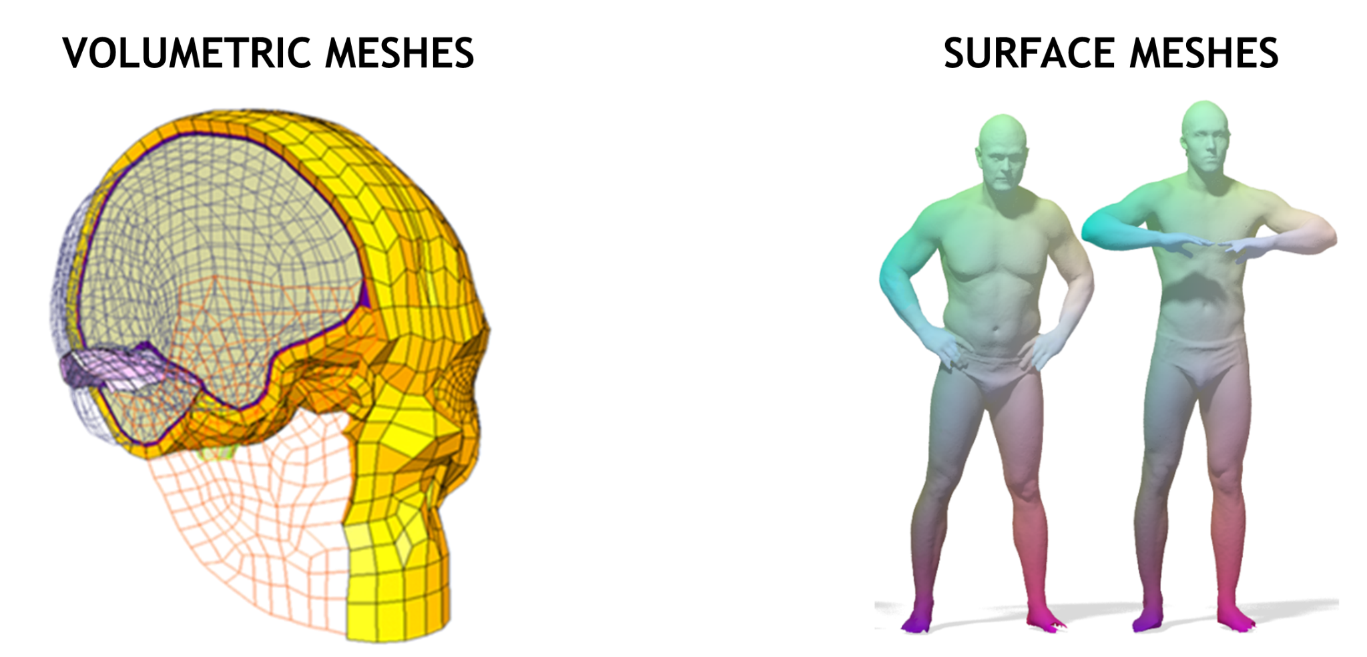
Graph Data
Used for Representing Unstructured Data

Slide 5
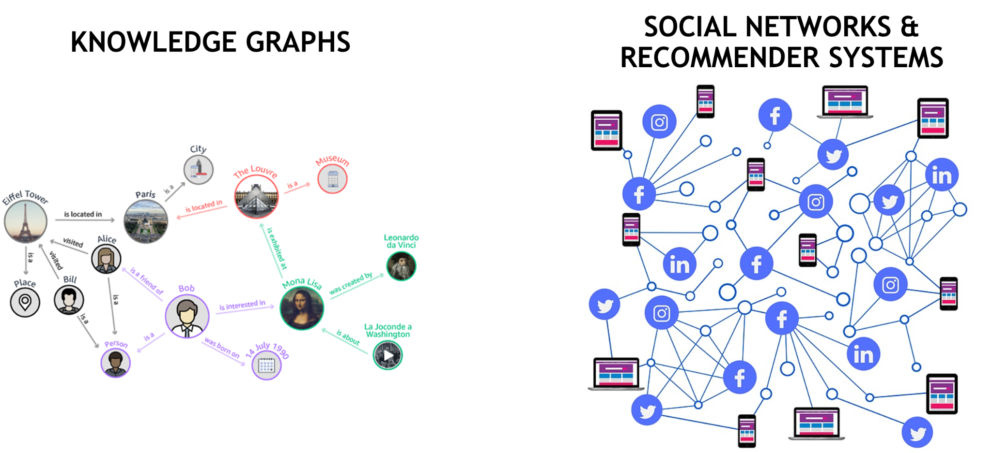
Common Graph Data Use Cases
Used to gather information about relationships between objects

Slide 6
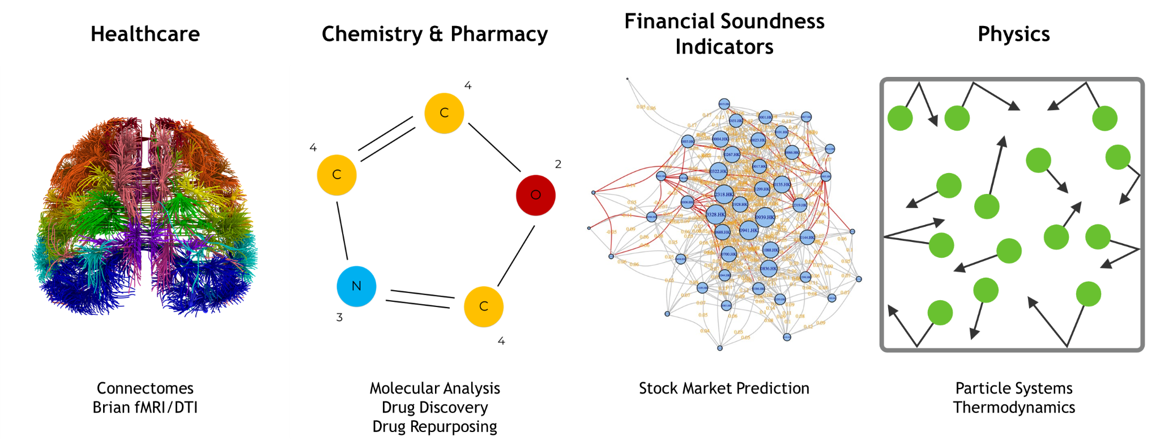
Common Graph Data Use Cases
Usage extends across industries

Slide 7
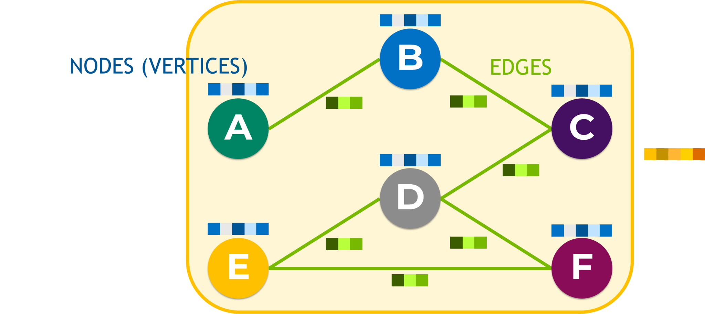
Anatomy of a Graph

Slide 8
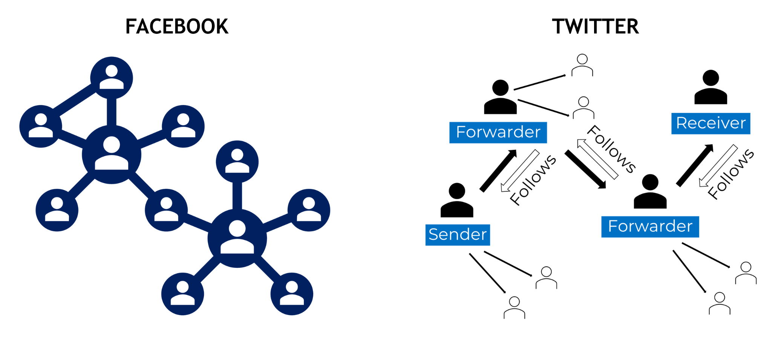
Edges
Directed, undirected, weighted, and unweighted

Slide 9
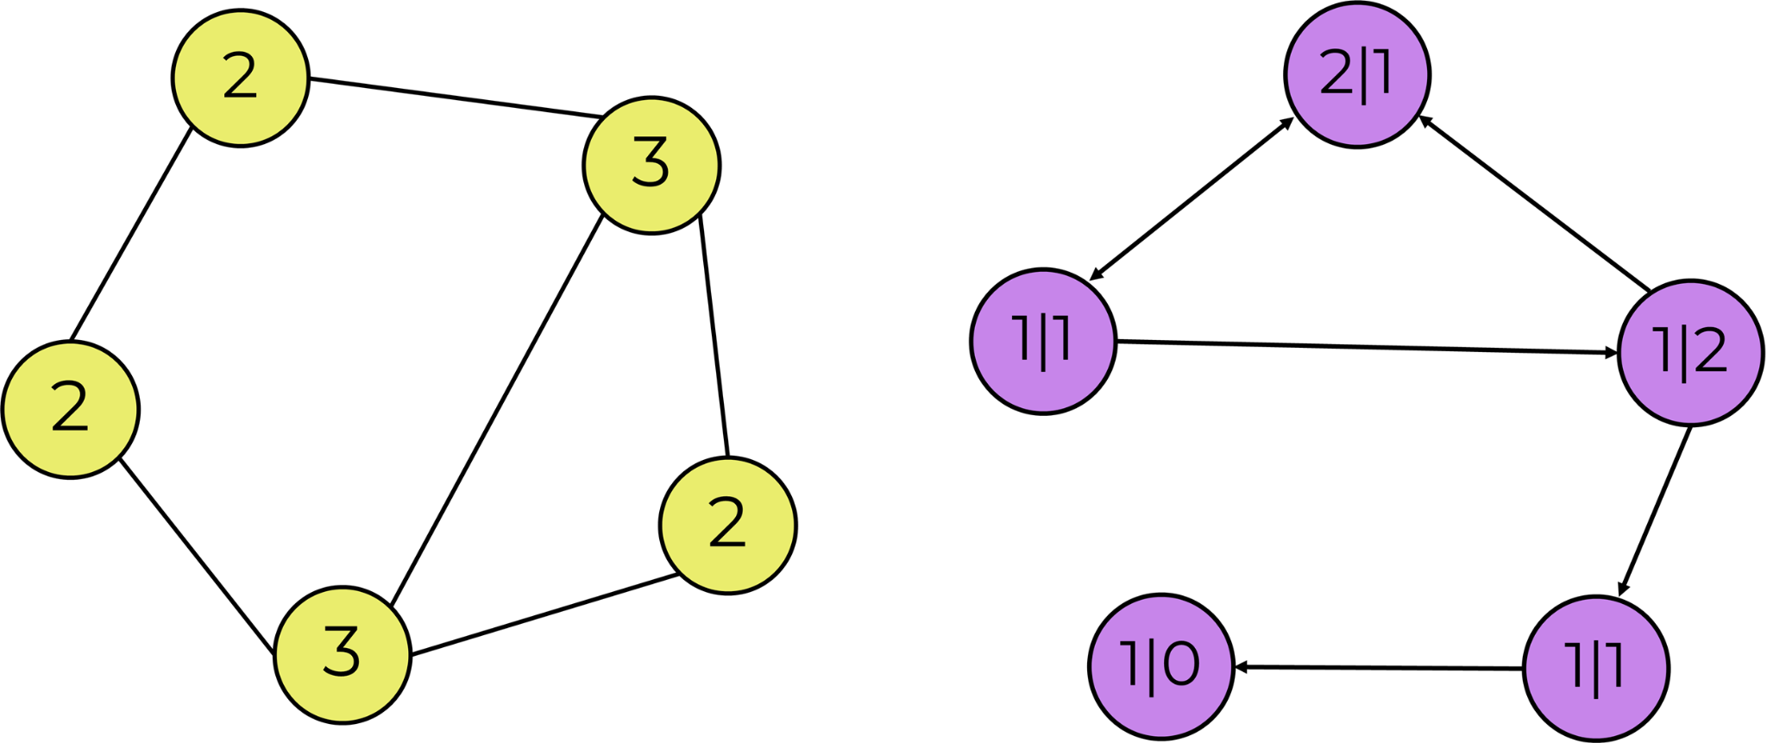
Edges
Degree, in-degree, out-degree

Slide 10
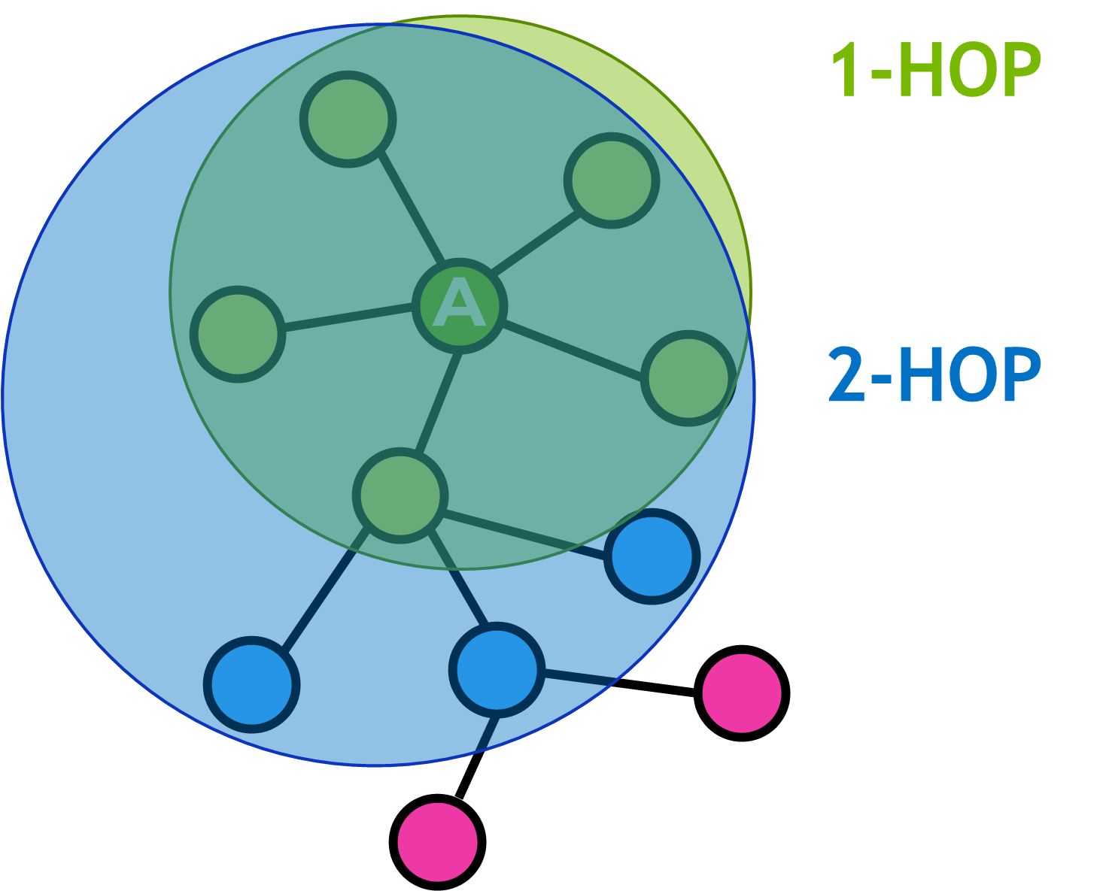
Edges
Neighborhood

Slide 11
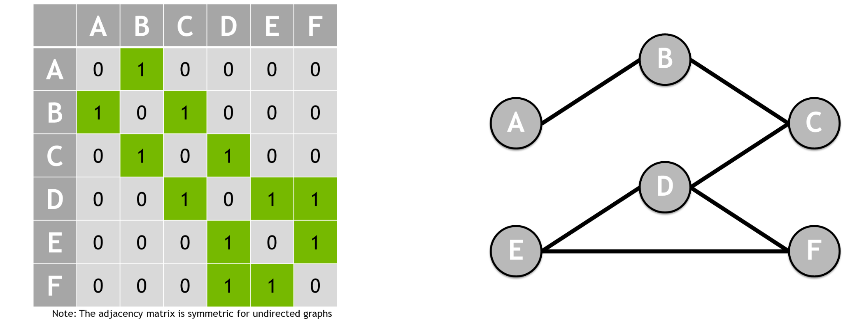
Representing Graphs
Adjacency matrix shows the neighborhood of each node

Slide 12

Representing Graphs
Adjacency matrix can also be used for a weighted graph

Slide 13
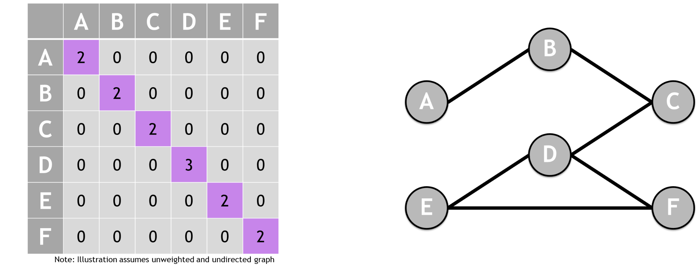
Representing Graphs
Degree matrix counts number of connections to each node

Slide 14
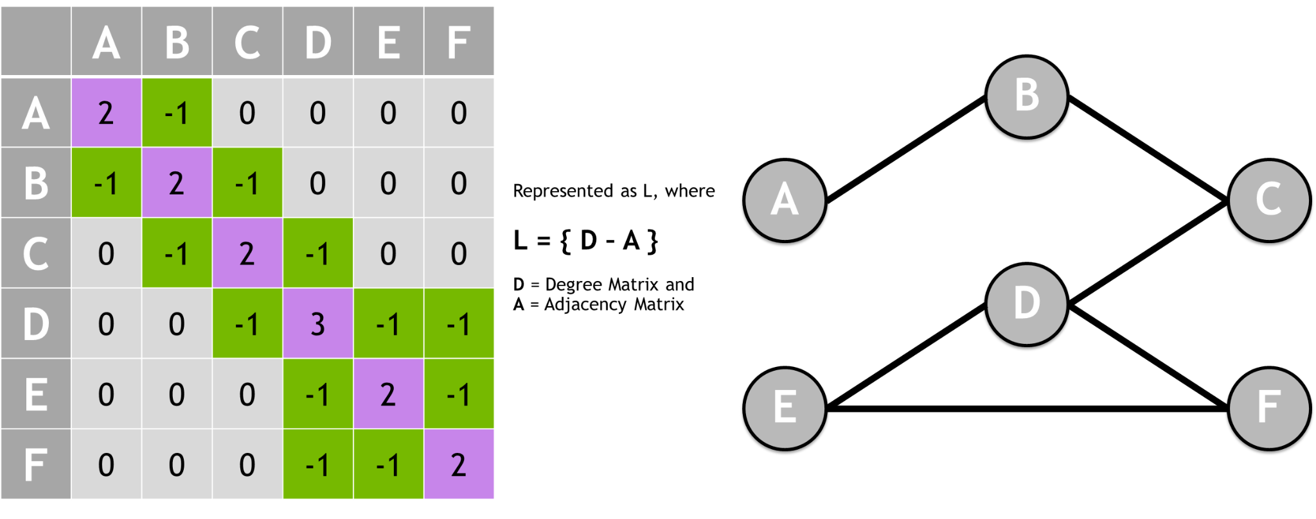
Representing Graphs
Laplacian matrix shows the smoothness of the graph

Slide 15
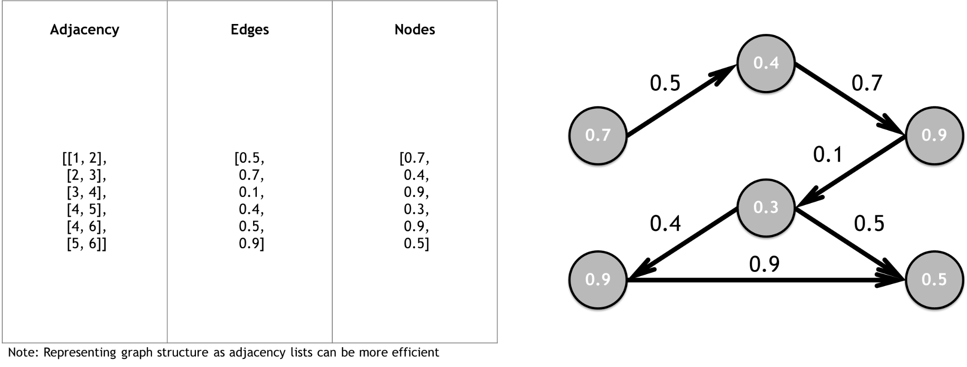
Representing Graphs
Graphs can also be represented by an adjacency list

Slide 16
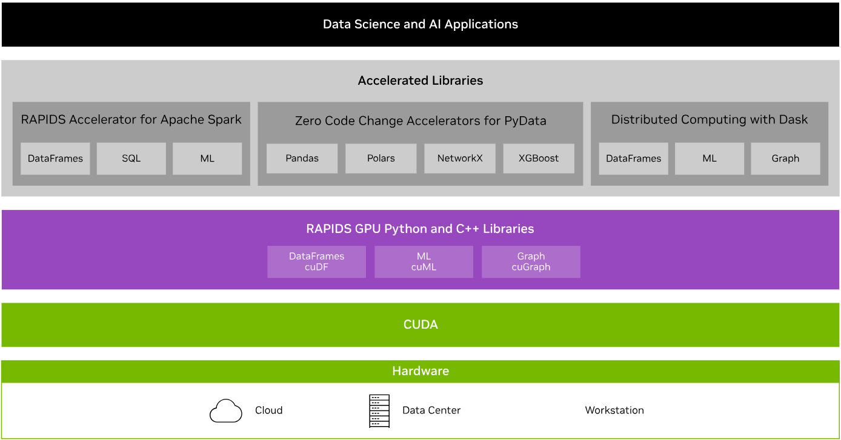
RAPIDS Transforms Data Science
An optimized hardware-to-software stack for the entire data science pipeline

Slide 17
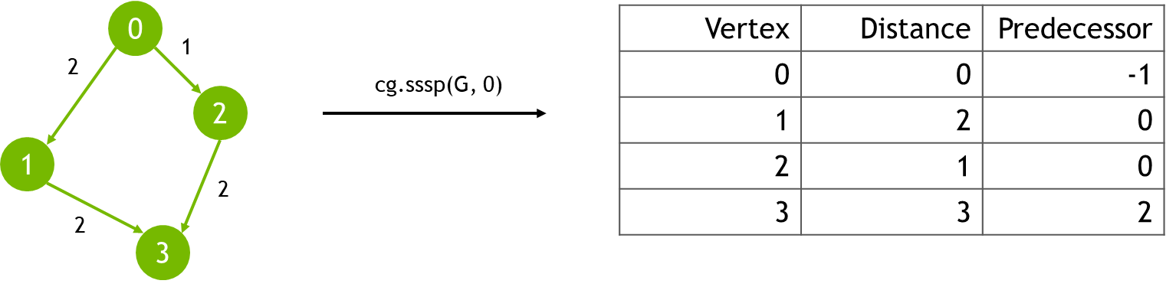
Single-Source Shortest Path
Computes the shortest path from a designated source node to all other reachable nodes in a weighted graph
Input: Graph (w/o negative-weight cycles), Node ID
Output: Vertex, Distance, Predecessor columns
Use cases: road networks, logistics, communications, and network analysis.

Slide 18
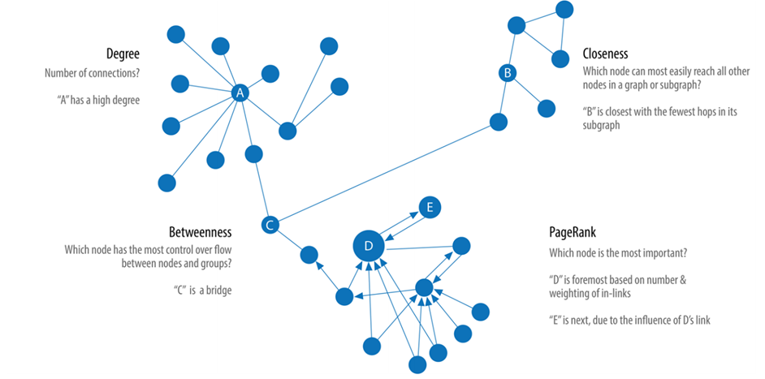
Centrality
Measuring different aspects of importance of nodes within a network

Slide 19
nx-cugraph
NetworkX backend that provides GPU acceleration to many popular NetworkX algorithms
Aims to bridge the gap between the ease of use of NetworkX and the high-performance capabilities of GPU-accelerated graph analytics
There are 3 ways to utilize nx-cugraph
Environment variable at runtime: the NETWORKX_AUTOMATIC_BACKENDS environment variable can be used to have NetworkX automatically dispatch to specified backends. This will use nx-cugraph to GPU-accelerate supported APIs with no code changes
Backend keyword argment: NetworkX also supports explicitly specifying a particular backend for supported APIs with the backend keyword argument
Type-Based dispatching: for users wanting to ensure a particular behavior, without the potential for runtime conversions, NetworkX offers type-based dispatching. To utilize this method, users must import the desired backend and create a Graph instance for it.

Slide 20
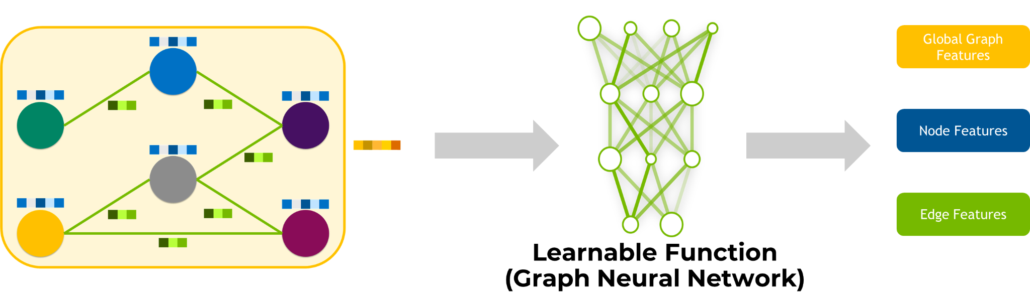
Graph Neural Networks
Learn the Function(s) to Predict Graph-Level, Node-Level, or Edge-Level Features

